Slide 1
Essential Question:
  How did England’s changing policy towards its North American colonies lead to a rising call for independence?
RQ 6B (p 178-194)
Notes:
Lesson Plan for August 28, 2008: RQ 6B, Path to Rev notes

Slide 2
Paying Off England’s National Debt
Notes:
This correlates to Chapter 7 in American Pageant

Slide 3
Parliamentary Sovereignty
1763 proved to be a critical year in colonial history:
  The end of the French & Indian War forced England to reexamine its colonial policies
  New political & economic restrictions emerged as England attempted to profit off its colonies
  Colonial resentment ultimately led to the American Revolution

Slide 4
The Sugar Act
  The Sugar Act redefined the relationship between America & England
Chief Minister George Grenville assessed England’s debt after the French & Indian War & concluded that Americans needed to contribute to maintain the army:
  Sugar Act of 1764
  Currency Act of 1764
  Quartering Act of 1765
  Stamp Act of 1765
Navigation Acts were based on mercantilism; The Sugar Act was an attempt to raise revenue
The Stamp Act led to the 1st real colonial protest against new British controls

Slide 5
The Sugar Act
The Sugar Act of 1764 placed a tax on imported sugar & created a means for the British to enforce it:
  Sugar was an expensive luxury, so colonial protest was limited to the gentry, merchants, & colonial assemblies
  Most colonists were unaffected by the new tax & there was no violence or mass protest

Slide 6
The Stamp Act
By taxing marriage licenses, property deeds, & playing cards, this duty affected common folks
One year later, the Stamp Act required colonists to buy a royal stamp to validate legal documents
  Colonial protest changed from a gentry movement to a mass protest by common citizens
  Massachusetts called for a Stamp Act Congress (an inter-colonial meeting) to petition the King & Parliament for a repeal
Notes:
7

Slide 7
The Stamp Act
Protest against the tax led to:
  Mob riots: Tax collectors resigned which made the stamp tax impossible to collect
  Boycotting British goods: “Save your money & you can save your country”
  The boycott mobilized women who were in charge of the home & dictated what families bought

Slide 8
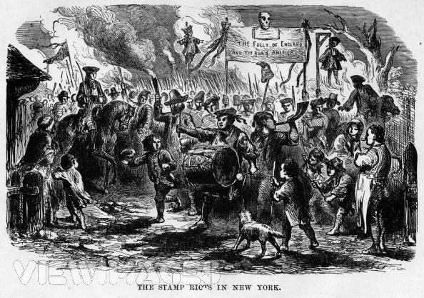
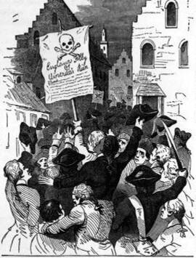
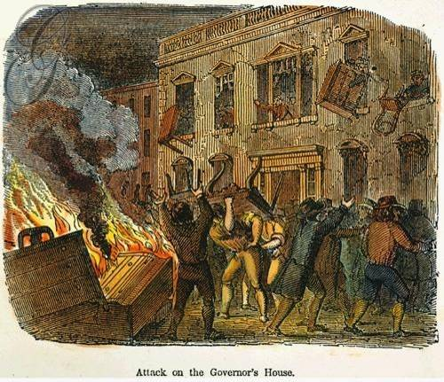
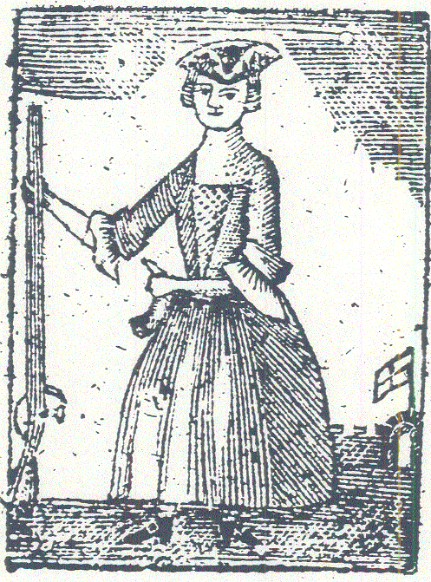
The “Sons of Liberty” were formed to protest British restrictions & became the leading agitators for colonial resistance
Women played a key role in maintaining the success of colonial boycotts
Mob reaction to the Stamp & Townshend Acts
For the 1st time, many colonists refer to fellow boycotters as “patriots”

Slide 9
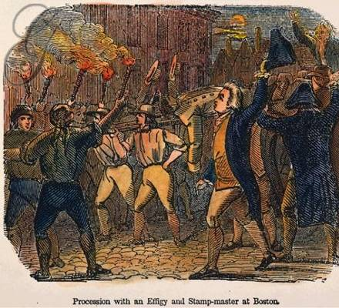
The Stamp Act
Due to effective colonial protest, England revoked the Stamp Act in 1766
However, Parliament issued the Declaratory Act of 1766 which reaffirmed Parliament’s sovereignty over the America colonies "in all cases whatsoever”
Notes:
8

Slide 10
The Townshend Duties
In 1767, Parliament initiated the Townshend Duties (a series of indirect taxes that the colonists weren’t supposed to notice):
  Taxed imports of paper, lead, glass, and tea
  Created a Board of Customs Commissioners to collect duties
  Ordered NY Gov to veto all laws by the colonial assembly until the Quartering Act was obeyed
Townshend attempted to avoid the same mistakes Grenville made
Notes:
9

Slide 11
Response to the Townshend Duties
Sons of Liberty (NY) organized a another boycott of British goods
  Issued a circular letter from the Massachusetts House of Reps to protest the Townshend Acts
  This “seditious letter” was considered an act of treason & the Massachusetts colonial assembly was dissolved
Notes:
10
This led to a huge issue of representative government

Slide 12
Response to the Townshend Duties
Effect:
  The crisis over colonial representation was now evident
  Colonies began communicating with each other effectively via committees of correspondence
  Colonies became united in their “moral” opposition to these English abuses

Slide 13
The Boston Massacre
England’s failure to remove the army from Boston heightened English-American tensions:
  Colonists resented the presence of this standing army
  In 1770, British soldiers fired into a crowd of colonists
  This “Boston Massacre” revealed the deterioration of Anglo-American relations
Notes:
11

Slide 14
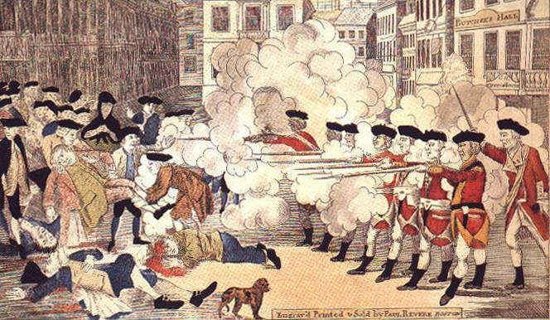
Paul Revere’s etching of the Boston Massacre became an American best-seller
Colonists injured British soldiers by throwing snowballs & oyster shells
With only 4 dead, this was hardly a “massacre” but it reveals the power of colonial propaganda
Notes:
11

Slide 15
The Boston Massacre
This tea tax was a symbolic reference to Parliamentary sovereignty
Tensions were defused by Lord North who repealed Townshend Acts in 1770; except a tax on tea:
  Most Americans backed off their radical protests
  Except the Sons of Liberty who continued their committees of correspondence to build up a communication network independent of the royal gov’t

Slide 16
The Boston Tea Party
In 1773, Parliament passed the Tea Act in order to help the British East India Company by making its tea cheaper to colonial buyers:
  Americans interpreted this act as a subtle ploy to get them to buy taxed tea
  In Dec 1773, Boston protestors dumped a shipment of British tea into Boston harbor
Notes:
13

Slide 17
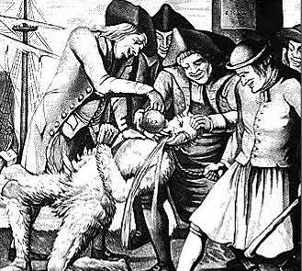
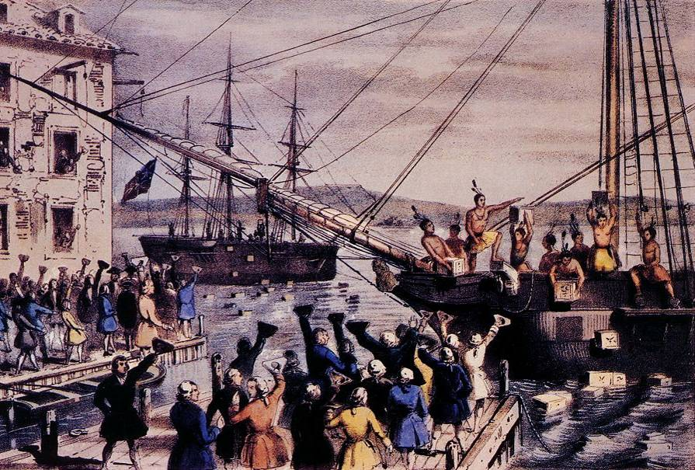

Slide 18
Coercive (Intolerable) Acts
Parliament retaliated against this act of insubordination with the Coercive Acts in 1774:
  Closed the port of Boston until the destroyed tea was paid for
  Massachusetts town meetings were limited to once per year
New England, Middle, & Southern colonists rallied to support Boston
Notes:
14

Slide 19
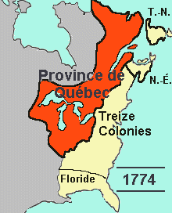
The Quebec Act (1774)
The Quebec Act created a gov’t for newly ceded Canada…but it lacked a colonial assembly
Colonists interpreted this as final proof of a Parliamentary plot to “enslave” America
“Canada” extended into the Ohio Valley & Mississippi which threatened all colonists
Notes:
15

Slide 20
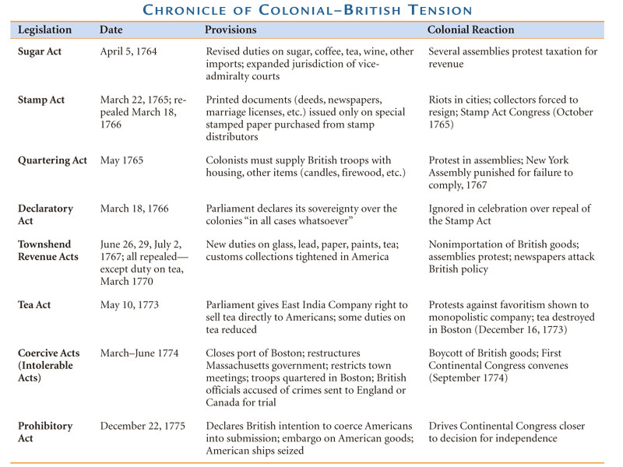

Slide 21
Steps Towards Independence

Slide 22
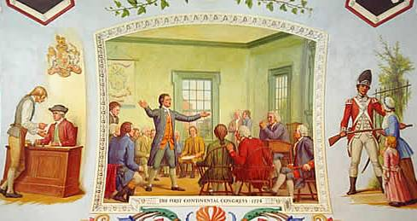
Steps Toward Independence
In Sept 1774, 55 delegates met in Philadelphia for First Continental Congress in response to the Coercive Acts:
  Suffolk Resolves urged forcible resistance to the Coercive Acts
  Formed an inter-colonial “association” to enforce a boycott with Britain until the Coercive Acts were repealed
Notes:
17

Slide 23
The Shot Heard Around the World
On April 18, 1775 a skirmish broke out in Lexington, Massachusetts
Fighting by colonial “minutemen” & British soldiers between Lexington, Concord, & Boston became the first exchange of hostilities between the English & Americans
Notes:
18

Slide 24
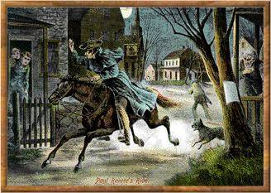
The British are coming!!
British soldiers were looking for contraband weapons & Sons of Liberty leaders John Hancock & Samuel Adams
Paul Revere & William Dawes made their midnight ride to warn the Minutemen of approaching British army

Slide 25
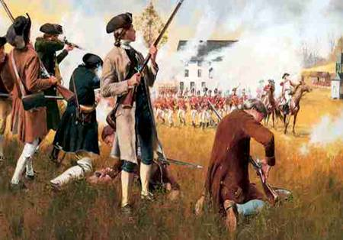
“The Shot Heard ‘Round the World”
“Americans displayed a…spirit against us, they never showed against the French”
Lexington & Concord—April 18, 1775

Slide 26
Early War Effort
On May 1775, Second Continental Congress met to direct the war:
  Appointed G. Washington to lead a new “Continental Army”
  Began purchasing war supplies
  Did not declare independence (delegates hoped to be seen as an expression of colonial opinion, not as a factional coup d’etat)

Slide 27
The Early War Effort
Dec 1775, Parliament passed the Prohibitory Act to restrict the colonists from trading with anyone
  English blockaded colonial ports & seized American ships
  Hired German mercenaries (Hessians) to fight the rebellion
  Royal governors urged slaves to rebel against their masters
Notes:
19

Slide 28
Conclusions
By December 1775, the British & American colonists were fighting an “informal revolutionary war”…but:
  Colonial leaders had not yet declared independence
  Most colonists were “loyal & dutiful subjects” of England & asked King George III to protect them against the king's ministers
  King George already considered the colonists in “open rebellion”

Slide 29
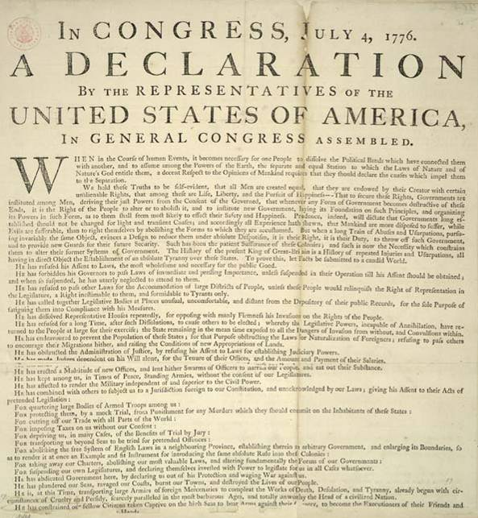
What’s Next?

